Slide 1
NFS Concepts
Version A.01
H3065S Module 8 Slides

Slide 2
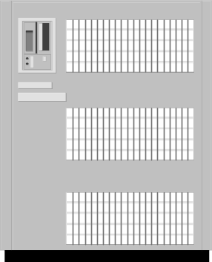
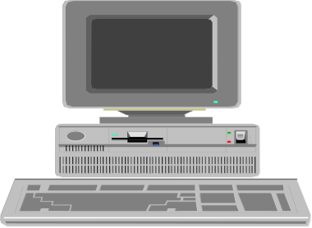
What Is NFS?
NFS is a network-based tool for sharing files and directories
across the network.
NFS works across multiple UNIX and PC platforms.
NFS allows transparent access to files from any node on the LAN.
/
etc
usr opt var tmp
application
Client Workstations
I need to share my
application with other
systems on the network.
files
a67374

Slide 3
What Files Should I Share via NFS?
Good candidates for file sharing via NFS
home directories
application files under /opt
operating System files under /usr
data files used by multiple nodes
/
usr opt home
application
Poor candidates for file sharing via NFS
files
device file directories /dev
system-specific configuration files under /etc
dynamic operating system files under /var
single-user mode command files under /sbin
a6987

Slide 4
NFS Definitions
File system A logical grouping of files and directories. Within an HP-UX system,
file systems are grouped together to form the UNIX system directory tree.
Server A machine that physically owns a file system that is to be shared partly or
completely across a network.
Client A machine that is using a file system that belongs to a server.
Export The method used by the server to make a file system available for sharing.
/
usr home var
Gary
Client
Exported
File system
Server
files
a67376

Slide 5
The NFS Remote Mount Model
Server
Client
/
/
etc
usr home var tmp
etc
usr
home
stand
var
opt
Gary
Keith
Julie
Gary
a67377

Slide 6
NFS Stateless Servers
The server machine
does not maintain state information
simply creates and returns a file handle when a client looks up a file
does not know which clients have file handles or have its files open
Implications
Operations that require state information (such as, file locking)
must be done via some other network service.
Servers must write all data to disk before returning
acknowledgments to a client.
a67378

Slide 7
NFS Is Built on Remote Procedure Calls
Client
executes
RPC call message
Server invoked
Procedure called
Server
Client
executes
blocks
procedure
Procedure returns
Client
Request completed
continues
execution
RPC return message
a67379

Slide 8
The portmap and rpcbind Daemons
Client
wants to make an RPC
Server
call (for example, to
RPC server (for example,
program number
Client
Server
mountd
) registers with
100005,
mountd
)
portmap/rpcbind.
opens socket and binds
- RPC program numbers
to address.
it can serve
attempts to contact
- port numbers on
(connect to)
which it awaits
portmap/rpcbind.
111
portmap/rpcbind
service requests
portmap/rpcbind converts
RPC program numbers to
port numbers.
inetd
listens on ports
1051
defined in
inetd.conf
,
including those registered
with portmap/rpcbind.
a67380

Slide 9
NFS PV2 versus NFS PV3
NFS PV2 was used through HP-UX 10.20.
NFS PV3 was first implemented at HP-UX 10.30.
Features and benefits of NFS PV3 include:
  added support for large files
  procedural and data structure changes
  improved performance
  changes to related protocols
a67381

